Slide 1
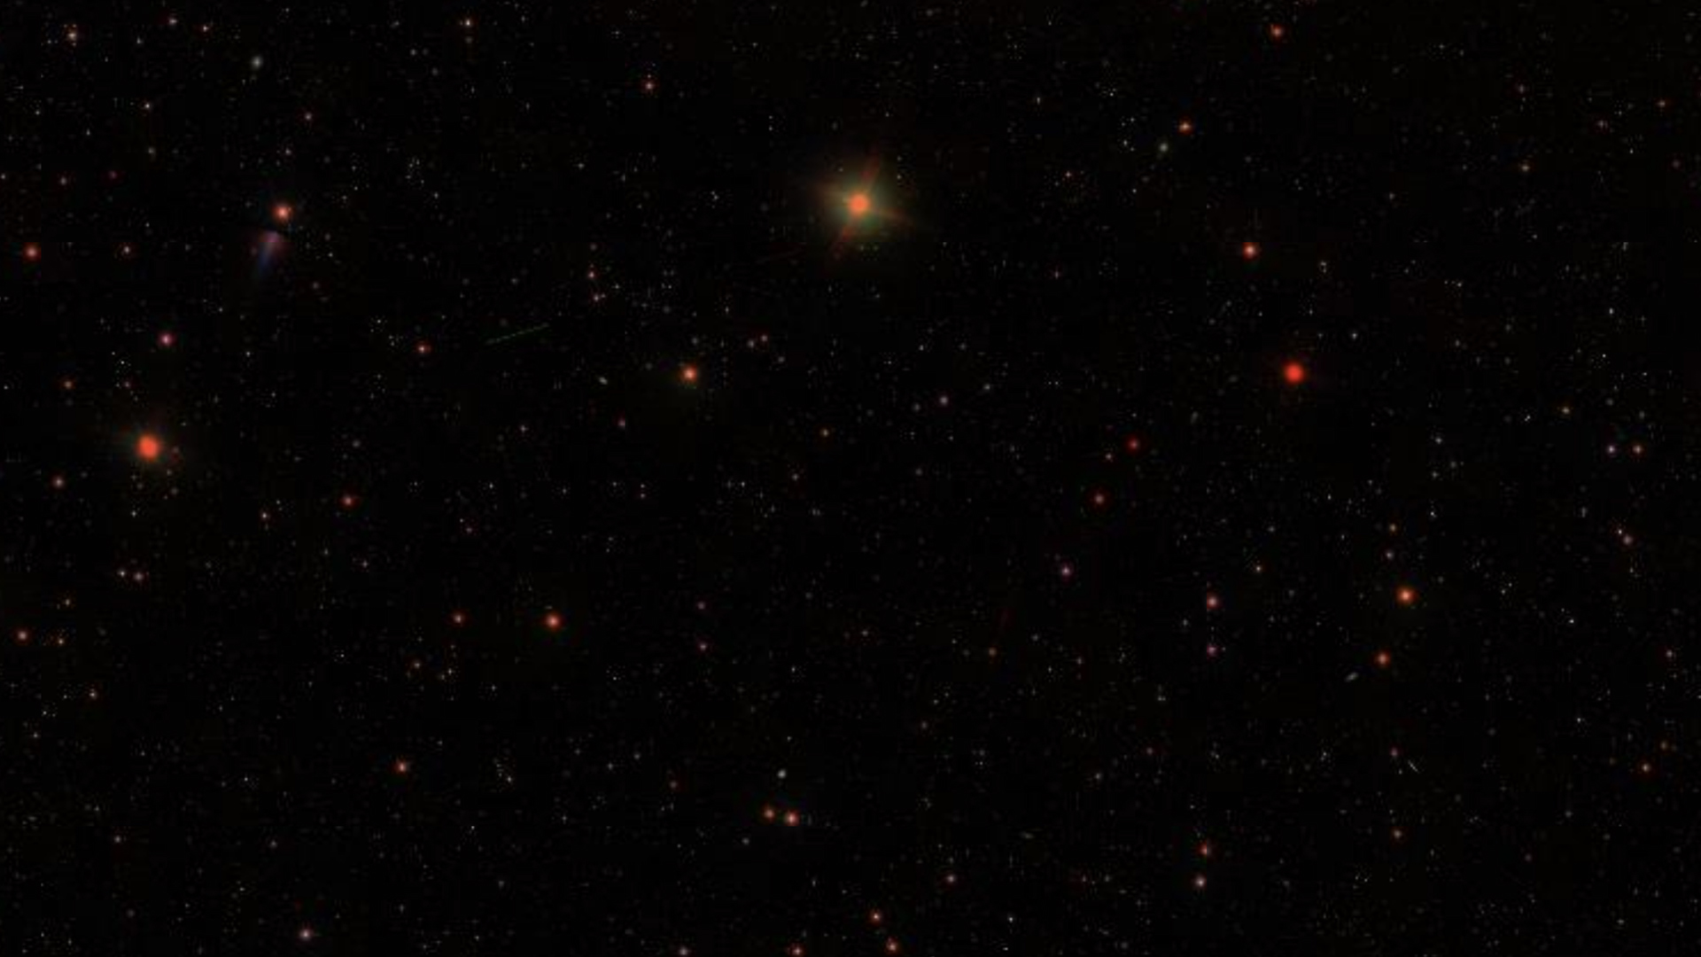
RESULTS
Show original FITS data next to log(N) plot
Show simulated data + object fitting
Show catalogue of objects w/ magnitude and position

Slide 2
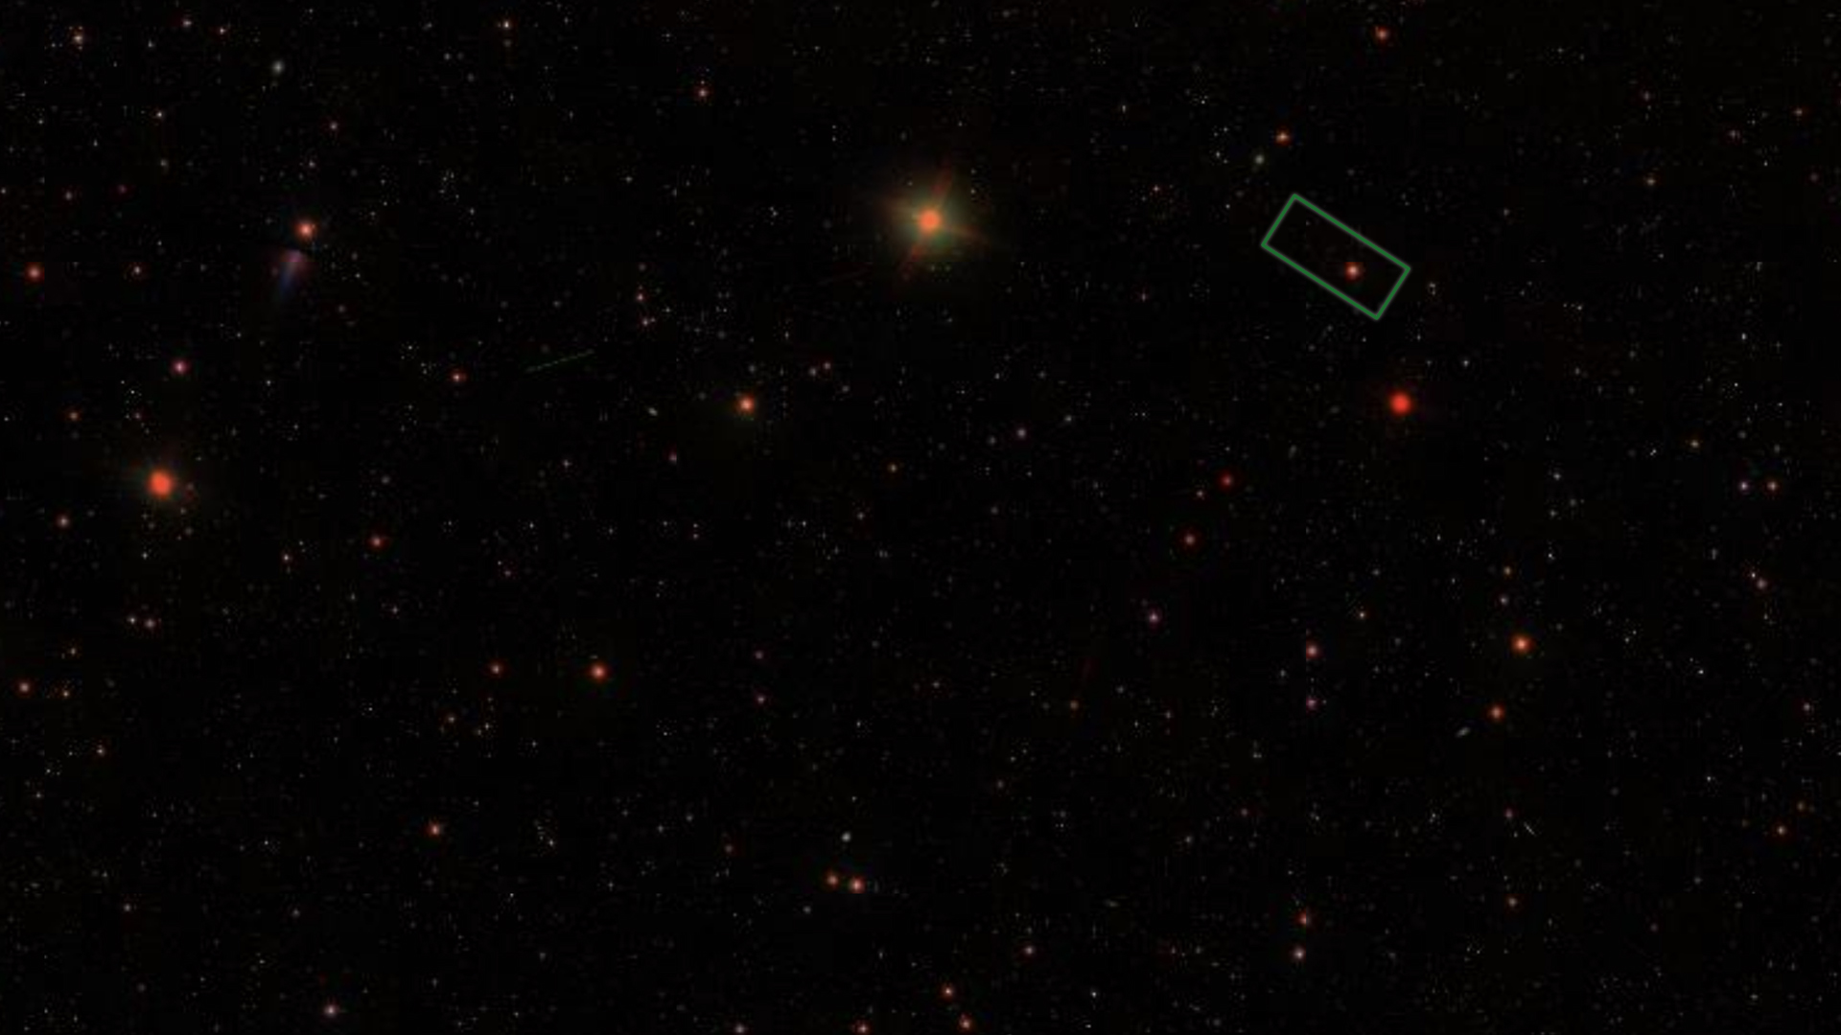
ASTRONOMICAL IMAGE PROCESSING
DAVID BATES & SUKORNO ASAD

Slide 3
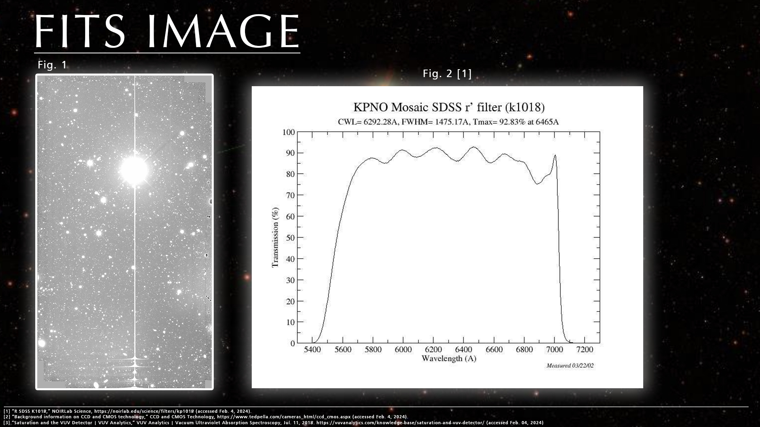

Slide 4
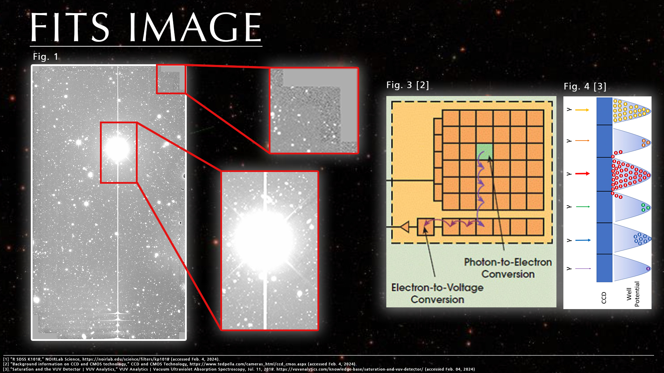

Slide 5
AIMS
Correct for background count
Isolate and label objects
Use pixel count of each object to find magnitude
Store data for each object in a catalogue
Categorise objects into either star or galaxy
Plot log(N) cumulative freq. of object count against magnitude

Slide 6
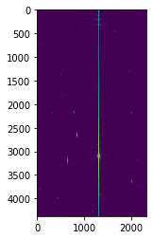
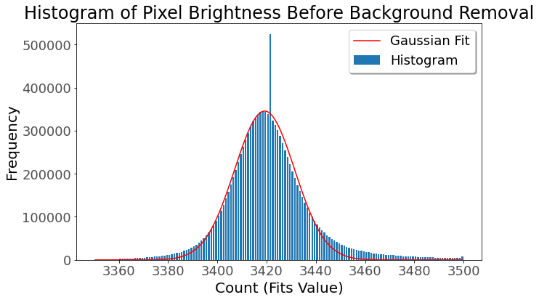
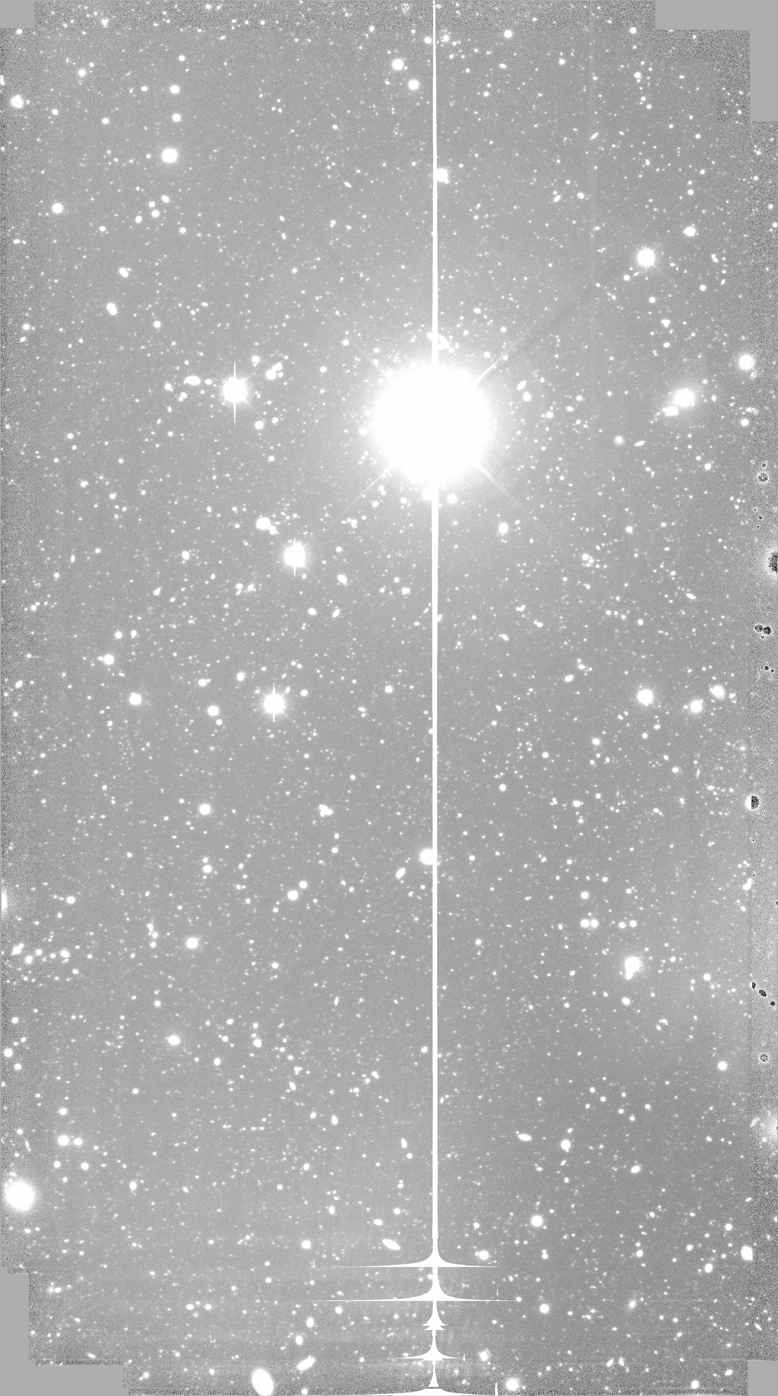
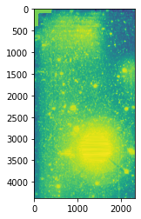
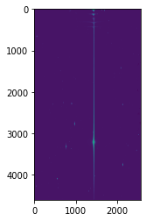
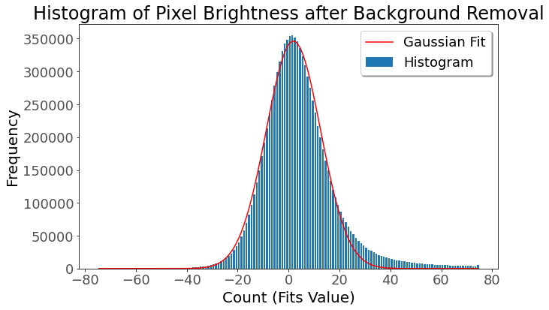
BACKGROUND MASK
corrected

Slide 7
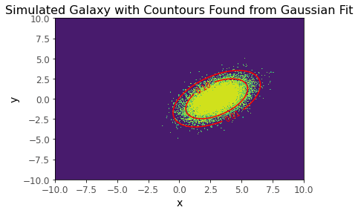
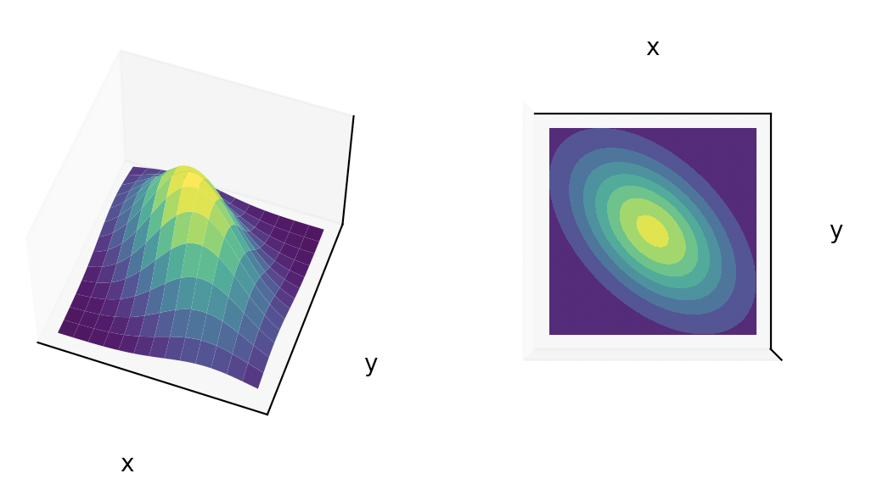
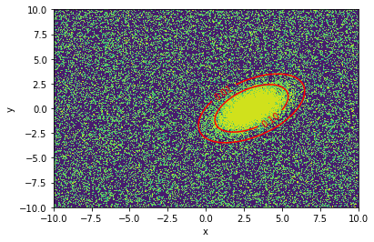
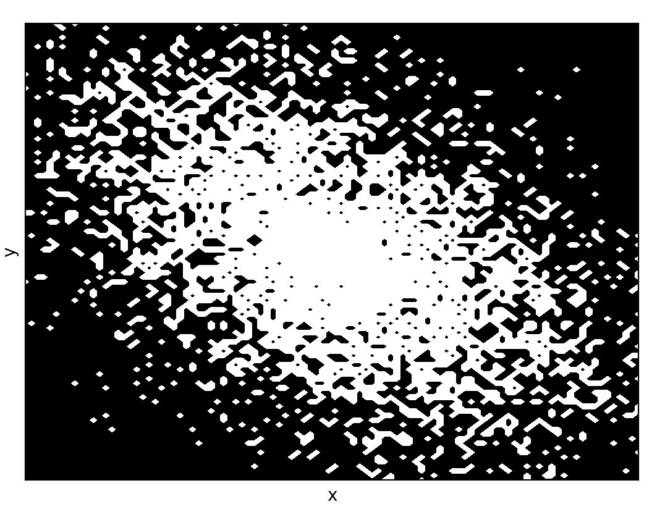
SIMULATED DATA
simulated gaussian
(suk)
multiple galaxies simulated
and fitted

Slide 8
OBJECT IDENTIFICATION
Baye’s factor to determine Star vs Galaxy
Gaussian vs non-Gaussian
galaxy detection

Slide 9
Log(N) Plot & Catalogue
log plot
catalogue

Slide 10
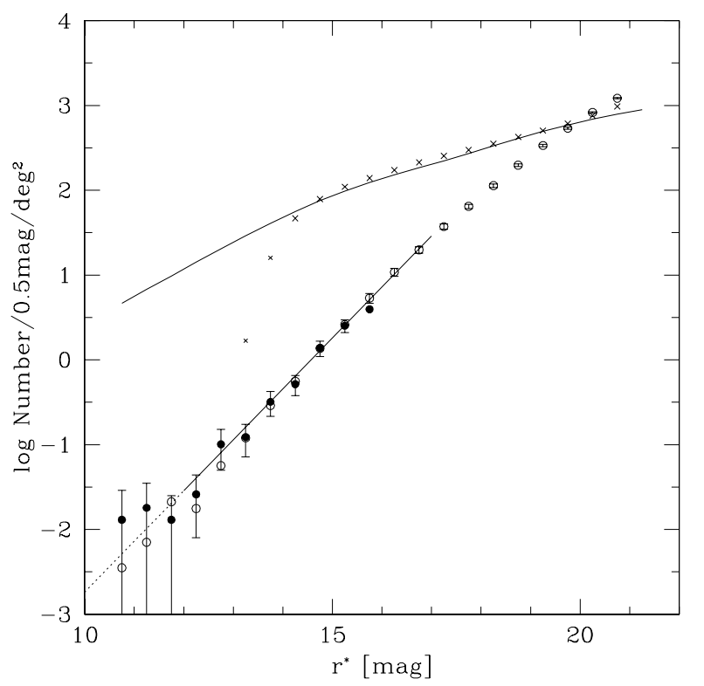
Discussion
our log plot
disagreements
signs of galaxy evolution:
deceleration q₀
no-evolution models underpredict faint counts
[4] Yasuda, N., et al. "Galaxy number counts from the Sloan Digital Sky Survey commissioning data," in The Astronomical Journal, vol. 122, no. 3, pp. 1104, 2001.
[5] “Durham Physics Cosmology Research Galaxy Counts,” star-www.dur.ac.uk. http://star-www.dur.ac.uk/~nm/pubhtml/counts/counts.html (Accessed Feb. 04, 2024)
[6] Metcalfe, N., et al. "Galaxy formation at high redshifts," in Nature, vol. 383, no. 6597, pp. 236–239, 1996. ‌

Slide 11
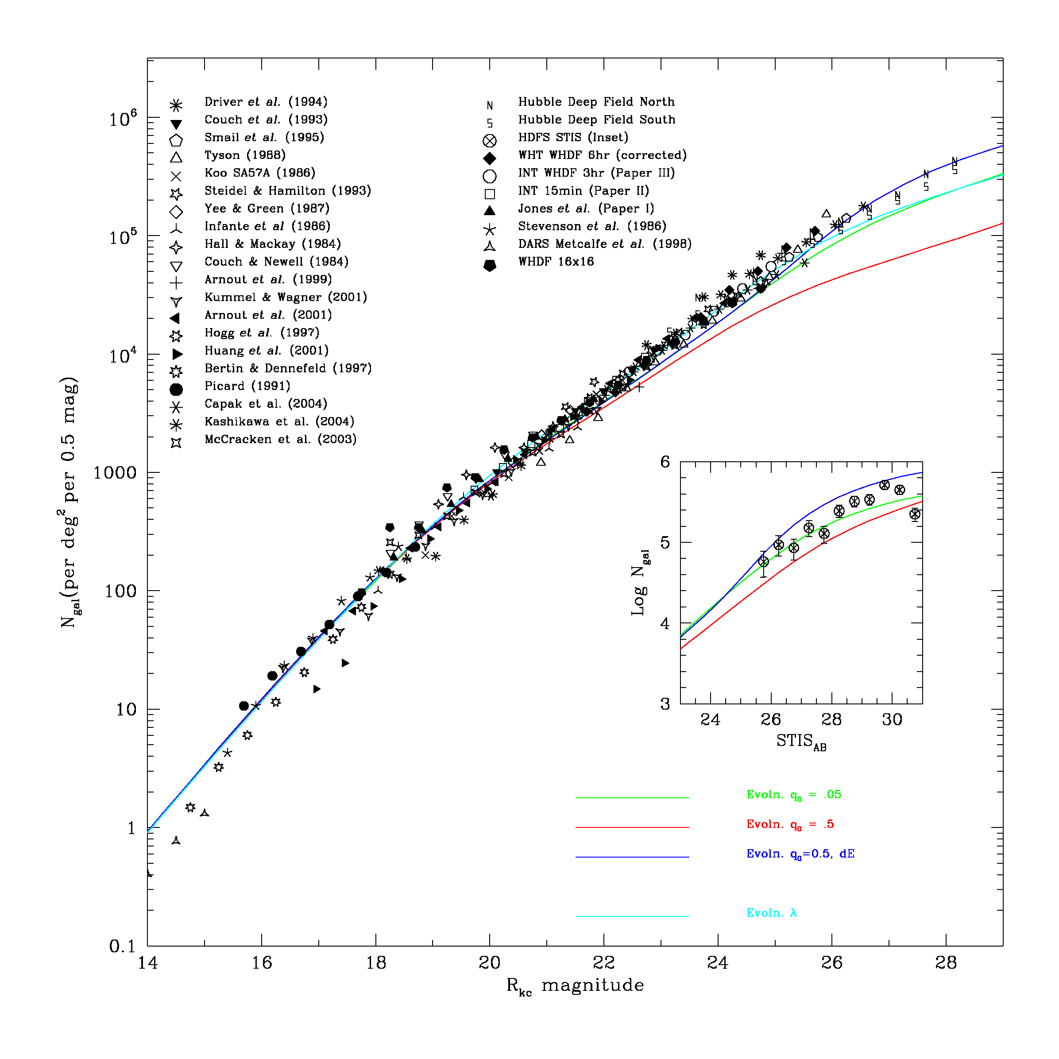
Discussion
our log plot
disagreements
signs of galaxy evolution:
deceleration q₀
no-evolution models underpredict faint counts
[4] Yasuda, N., et al. "Galaxy number counts from the Sloan Digital Sky Survey commissioning data," in The Astronomical Journal, vol. 122, no. 3, pp. 1104, 2001.
[5] “Durham Physics Cosmology Research Galaxy Counts,” star-www.dur.ac.uk. http://star-www.dur.ac.uk/~nm/pubhtml/counts/counts.html (Accessed Feb. 04, 2024)
[6] Metcalfe, N., et al. "Galaxy formation at high redshifts," in Nature, vol. 383, no. 6597, pp. 236–239, 1996. ‌

Slide 12
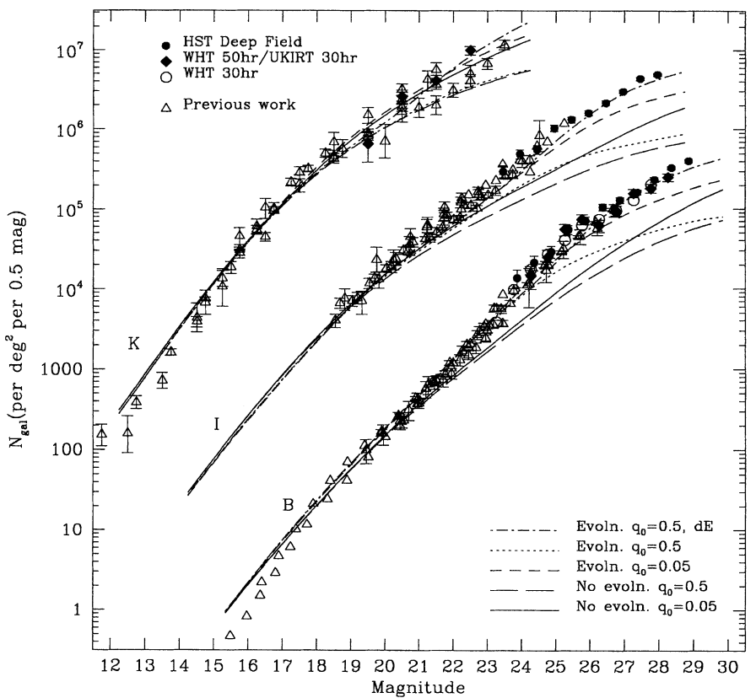
Discussion
our log plot
disagreements
signs of galaxy evolution:
deceleration q₀
no-evolution models underpredict faint counts
[4] Yasuda, N., et al. "Galaxy number counts from the Sloan Digital Sky Survey commissioning data," in The Astronomical Journal, vol. 122, no. 3, pp. 1104, 2001.
[5] “Durham Physics Cosmology Research Galaxy Counts,” star-www.dur.ac.uk. http://star-www.dur.ac.uk/~nm/pubhtml/counts/counts.html (Accessed Feb. 04, 2024)
[6] Metcalfe, N., et al. "Galaxy formation at high redshifts," in Nature, vol. 383, no. 6597, pp. 236–239, 1996. ‌

Slide 13
THANK YOU FOR LISTENING

